Slide 1
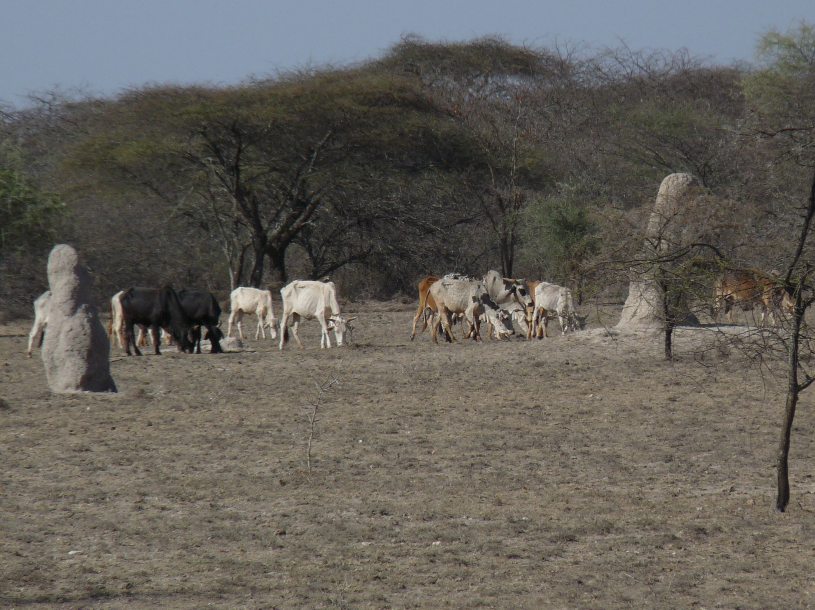

Christopher B. Barrett
Cornell University
World Bank seminar “Resilience in the Face of Poverty Traps”
Washington, DC
December 7, 2018
Human Capabilities and Poverty Dynamics in the Face of Agro-Ecological Shocks

Slide 2
Core issues
Poverty traps may arise via several mechanisms in places where multiple markets fail at least some people.
Major challenges:
Different – or no ! – poverty trap mechanisms may apply to different people.
Different poverty trap mechanisms carry different policy implications.

Slide 3
Findings
Santos & Barrett (chap. 7) find, studying southern Ethiopian (Borana) pastoralists:
Poverty traps only arise due to drought years.
Herder ability – e.g., heterogeneity in skill to deal with drought – reveals distinct wealth dynamics, with at least two distinct groups within these communities.
The different groups need different types of assistance. One-size-fits-all policies commonly inefficient.

Slide 4
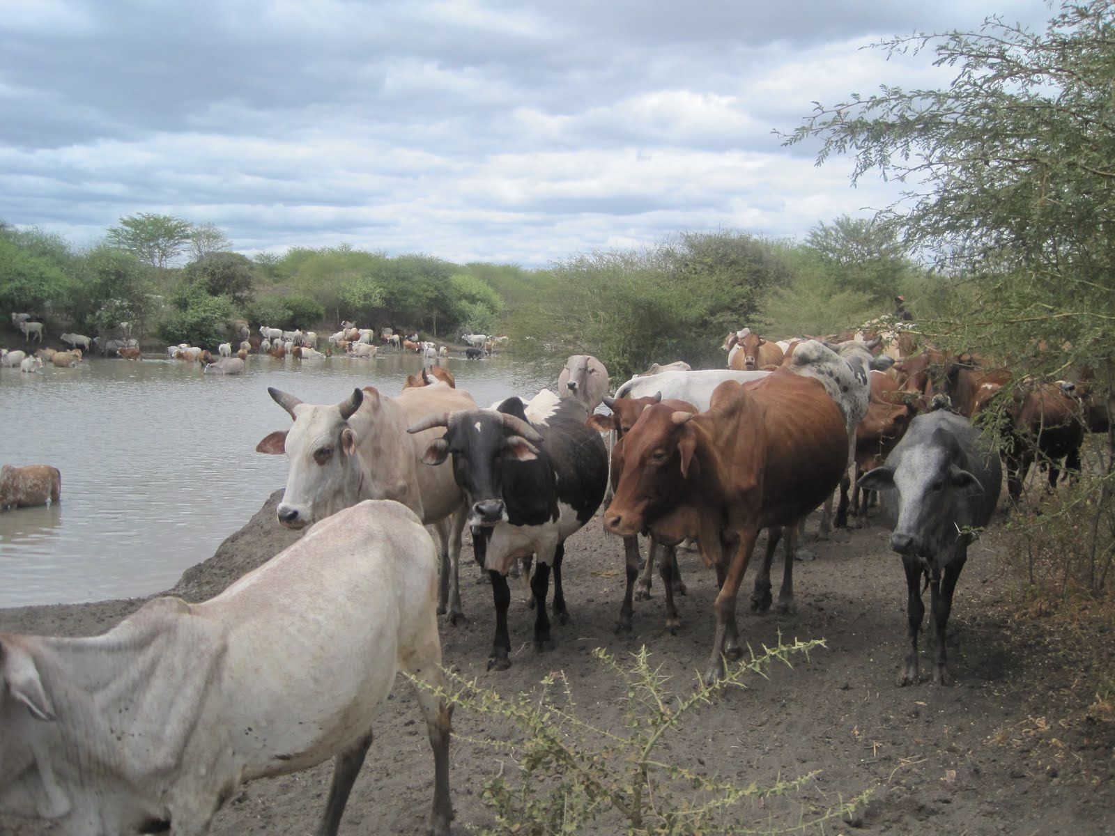
State-conditional herd growth
Elicited pastoralists’ beliefs about herd growth under different (and their expected) rainfall conditions.
Under normal/good rainfall, virtually universal expectations of near-linear growth, with minimal dispersion among herders.

Slide 5
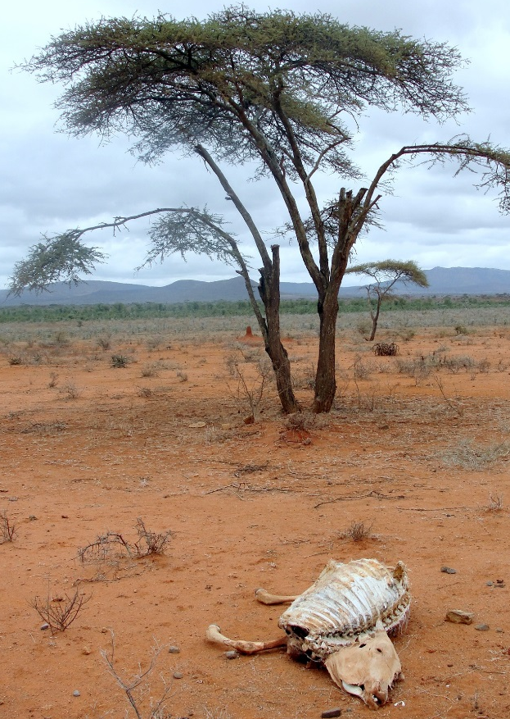
State-conditional herd growth
But in drought years, considerable dispersion, and highly nonlinear herd dynamics … suggests that multiple equilibria poverty trap seen in data arises due to drought risk. Insurance and risk management ability become important differentiators.

Slide 6
Expected herd dynamics with stochastic weather
Blend state-specific results That strongly resemble observed
and get overall dynamics: (Lybbert et al EJ 2004):
For coarse methods, very strong correspondence: equilibria and expected dynamics very similar.

Slide 7
Herder ability and expected herd dynamics
Now divide sample into two: lower ability group (4th quartile of the herding ability dist’n) and the rest. Re-estimate herd growth models for each sub-sample.
Find 2 distinct herd dynamics:
1. Low ability herders have just
one low-level equilibrium. Their
herds collapse inevitably.
2. Higher ability herders face
multiple dynamic herd equilibria.
Give them adequate herd, and
They can remain viable.

Slide 8
The policy challenge
In this region, perhaps the most common post-drought policy intervention (pre-insurance) was herd restocking.
With heterogeneous ability,
targeting becomes critical
because expected returns vary
based on recipient ability.
Only higher ability herders w/
initial herds of 9-22 TLU grow
herds following restocking.

Slide 9
The policy challenge
We often/understandably target the poorest … but poverty is correlated with both ability and herd size. If we target those with adequate herd size (or adequate herd size and ability), could substantially increase ROI from herd restocking.
Targeting method ROI pa
Naïve (poverty status alone) -4.4%
Herd size 3.6%
Herd size and ability 5.4%

Slide 10
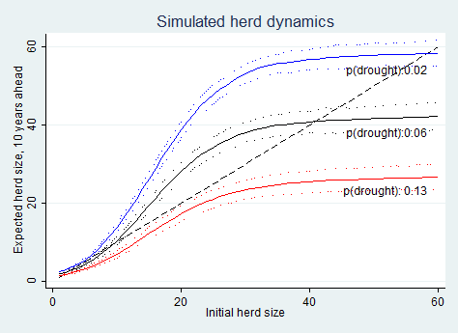
Climate change threat
Herd dynamics differ b/n good and poor rainfall states, so change w/ drought risk (<250 mm/yr).
In so. Ethiopia, doubling drought risk would lead to expected system collapse if no disruption to current herd dynamics.
‘thriving herds’ dynamics
Current Boran dynamics
‘collapse’ dynamics
Source: Barrett and Santos (Ecol Econ 2014)
Climate change may be shifting system dynamics. Interventions to reduce herd loss – like water point/rangelands maintenance - and/or accelerate herd recovery – like livestock insurance – can affect balance between the two groups of pastoralists.

Slide 11
Conclusions
Even in a ‘simple’ system, heterogeneous wealth dynamics demand multiple responses
Weather shocks give rise to one sort of poverty trap for herders of average or better ability
Low ability generates a different sort of poverty trap
This matters for policy since the mechanism(s) behind growth dynamics – and persistent poverty – matters to the impact of interventions:
  Risk management may be as/more valuable than transfers for some, but merely delay the inevitable for others.
  Targeting of social protection matters a lot

Slide 12
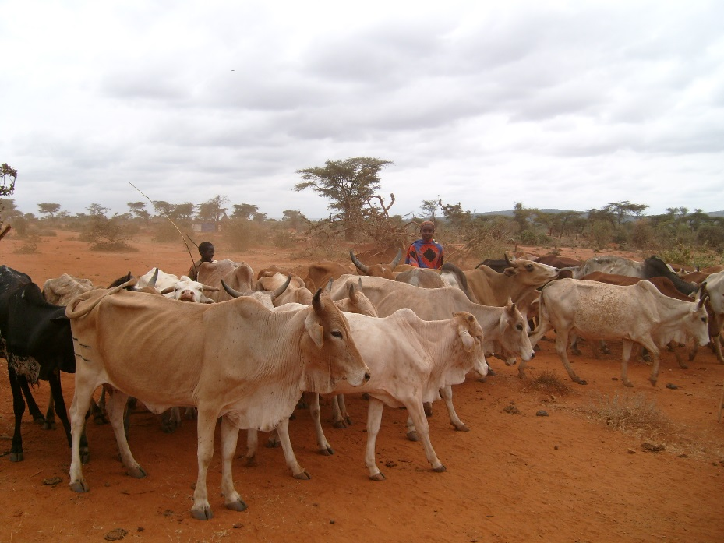
Thank you for your time and interest!

